Slide 1

Cybersecurity
Virtual Stem Camp 2020

Slide 2
Agenda
Introduction
10 Principles of Cybersecurity
Lockpicking Demo
Cryptography
Social Engineering Basics
Q&A

Slide 3

10 Principles of Cybersecurity

Slide 4
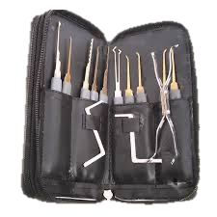
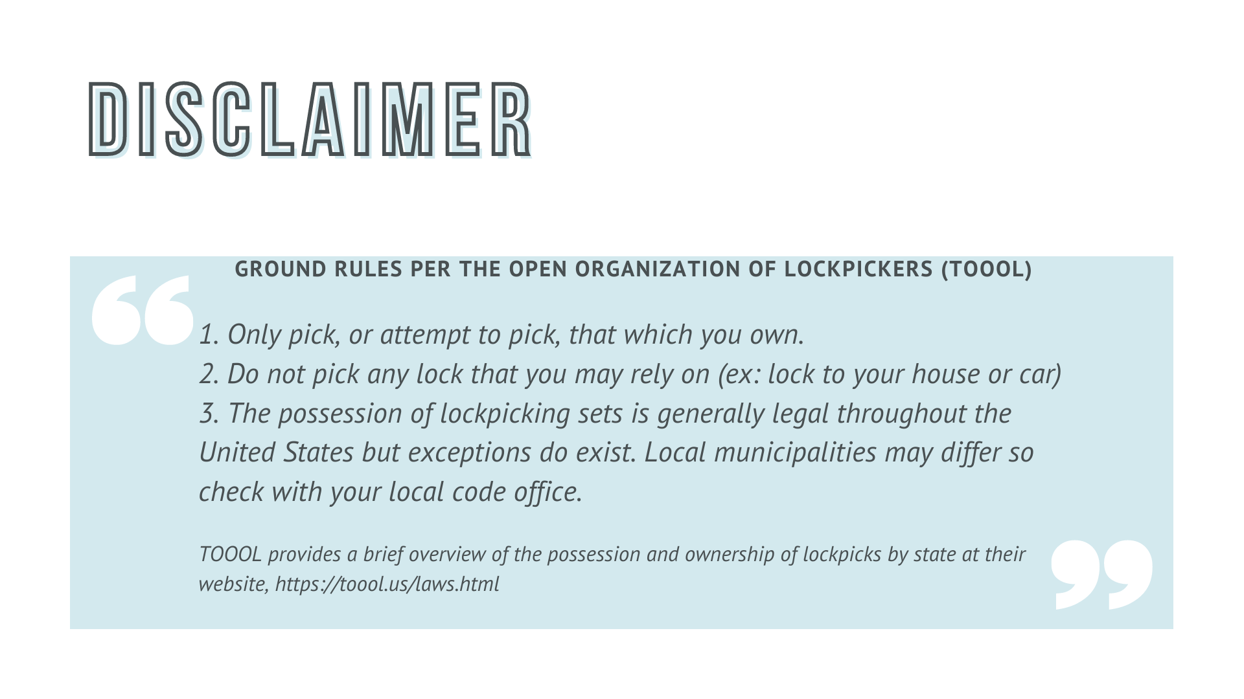

Supplies You’ll Need

Slide 5
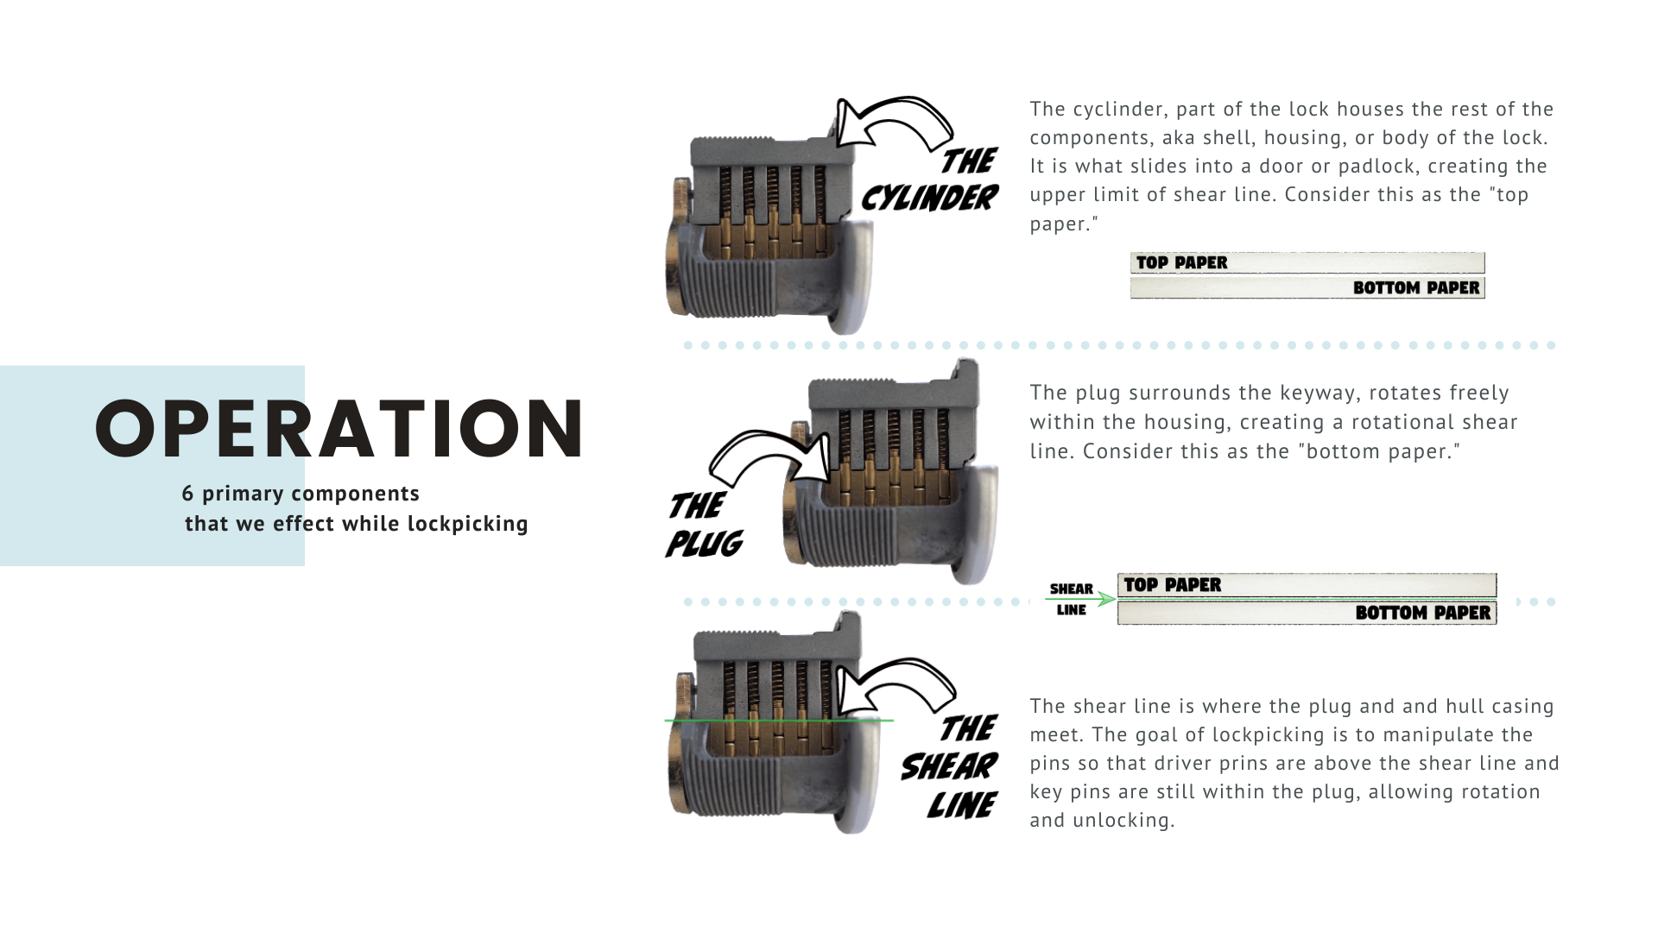
Notes:
Cyclinder – is the top of the lock that holds all the other parts. This the top paper.
Plug – the bottom part of the lock that is around the key opening.
Shear line – is where the cyclinder and the plug meets, this is similar to the space both of the papers.
* Remove lockpicking goals.

Slide 6
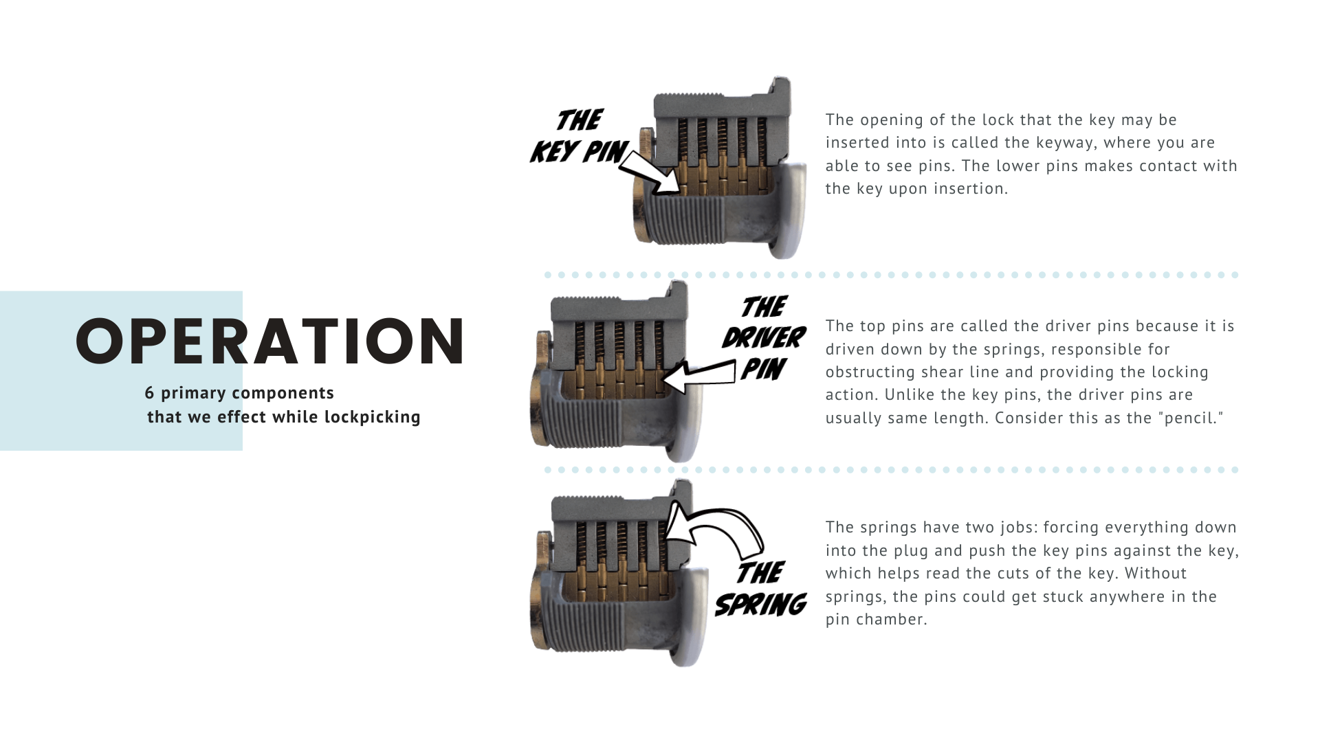
Notes:
Key pins are the lower pins in the lock. You are able to see when you look into the lock opening.
Driver pins – are top pins in the lock because it’s driven by the springs. It’s responsible for blocking the shear line. The difference between the driver pins and the key pins are that they are the same size. You could consider this to be the pencil.
Springs – controls where the pins are. Without the springs

Slide 7
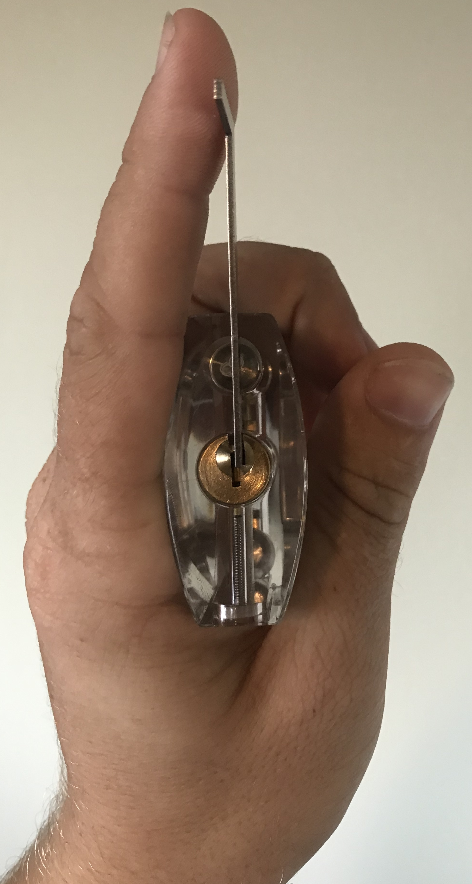
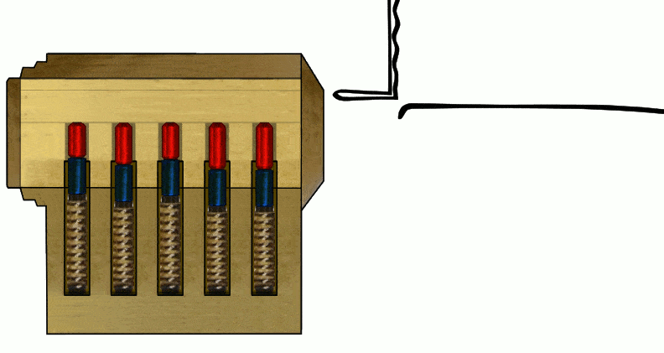
Lockpicking
1. Begin by holding the lock in a comfortable manner in your left hand with the torque wrench inserted.
2. Wrap your left thumb around the bottom of the lock to provide support and your left index finger straight up to provide tension to the torque wrench.
3. Holding your pick as you would a dart, grasping it with your index finger and thumb, insert it into the lock all the way to the back.
4. As you get near the back of the lock, begin applying tension with your left index finger on the torque wrench.
5. When the pick is at the back begin to draw the pick forward, pushing down gently against the key pins as you continue to provide even pressure on the torque wrench.
6. The process of pushing and pulling the pick against the pins is called raking. If the lock does not open within three to four rakes, release tension on the torque wrench and try again as it is possible that a pin has been pushed too far and is binding.
Notes:
1. Start with the lock in the hand that you don’t write with, put in the smaller part of torque wrench.
2. Wrap your left thumb around the bottom part of the lock to get a grip. Use left pointer finger straight up to apply pressure on the torque wrench.
3. Hold the pick as you would a pencil. Slide the pick into the key opening until you feel the last pin.
4. When you get to the back of the lock, start to apply pressure with your left pointer finger on the torque wrench.
5. You’ll continue step 4 while pulling the pick out and pressing down against the key pins.
6. This process of pushing and pulling the pick against the pins is called raking.

Slide 8
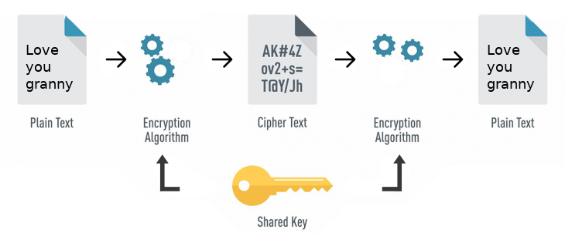

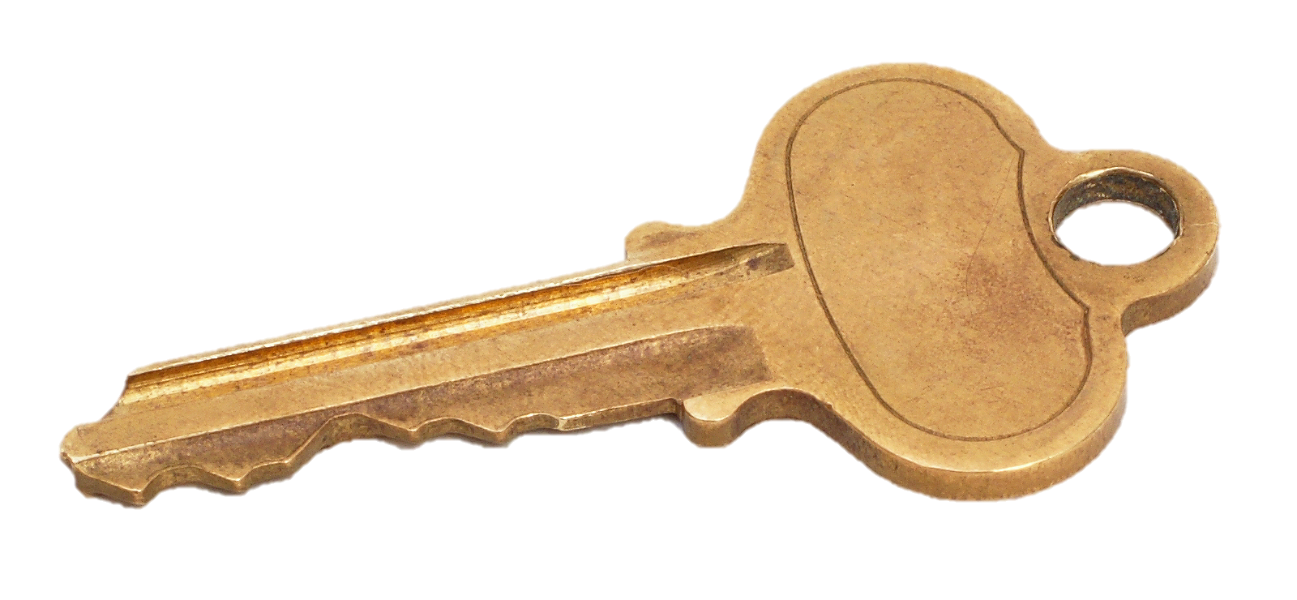





Cryptography
Symmetric
Asymmetric
Public Key
Private Key
Plaintext
Ciphertext
Plaintext
Plaintext
Ciphertext
Plaintext
Encryption
Decryption
Encryption
Decryption
Notes:
Lockpicking can be thought of as a physical model to a core digital security concept – cryptography. Which is the art of writing or solving codes
Symmetric – Can be explained when you are able to send information with a shared key.
An example of symmetric cryptography is a Caesar cipher.
An analogy could be that you have a locked box and made copies of that key for your friends so they can access anything in the box.
Asymmetric - If you wanted to plan a surprise party for a friend. You want to send invitations to the people you want to invite. Their addresses in this case are the public keys. When they send their RSVPs back to you, the private key is your mailbox as you’re the only person that can open your mailbox and read your mail.

Slide 9
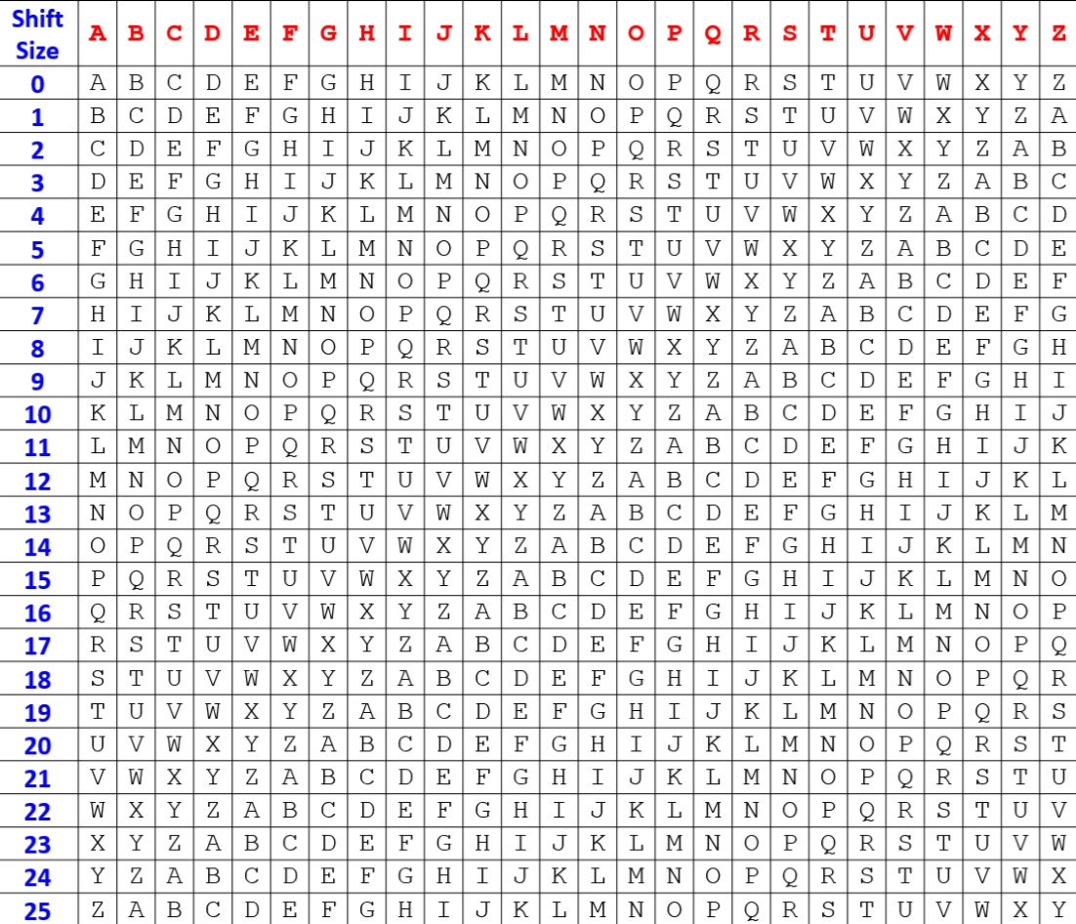
Caesar Cipher
Using a shift size of 3,
What is my name encoded?
What is your name encoded?
What does this encoded message say?
Wkdqnv iru mrlqlqj xv wrgdb!
Notes:
https://cryptii.com/pipes/caesar-cipher

Slide 10
Social Engineering
Have I been Pwned https://haveibeenpwned.com/
Strength of password https://www.my1login.com/resources/password-strength-test/
Strong Passwords https://strongpasswordgenerator.com/

